Slide 1

CALL HANDLER SYSTEM
Customer/Contract Handler Module

Slide 2

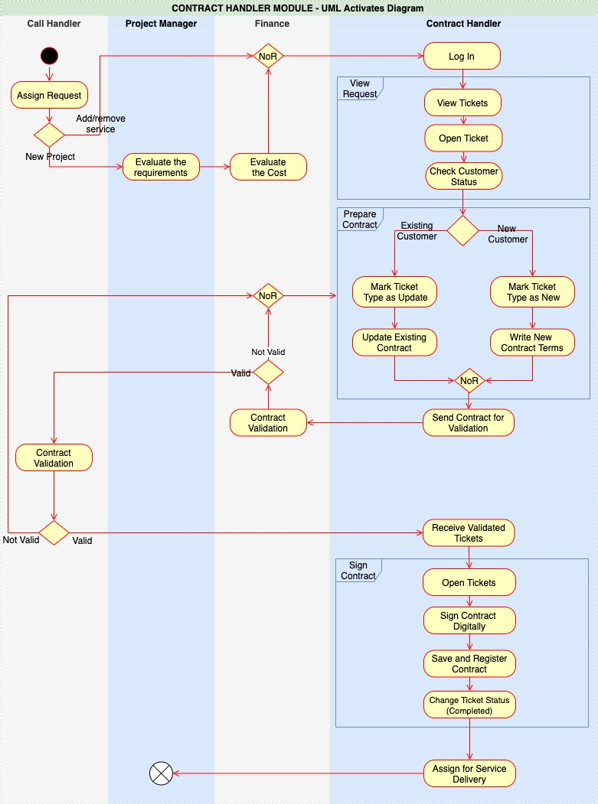
UML Activity Diagram

Slide 3
Requirements List
G1.R1)System Authentication: accessing the system using a contract handler user.
G1.R2)System Authorization: contract handler role and privileges.
G1.R3)Check Requests : display the assigned tickets by call handler and finance teams.
G1.R4)Determine ticket type (New or Update Contract).
G1.R5)Prepare the contract.
G1.R6)Send the contract to the finance team for validation.
G1.R6.1) Validate contract by finance team.
G1.R6.1.1) If the finance team doesn’t accept the contract, the contract returns back
for the contract handler for review (Go to G1.R5).
G1.R6.1.2) If the finance team accepts the contract then they forward it to the call
handler.
G1.R6.2) Call handler validates contract with customer.
G1.R6.2.1) If contract terms require revision/update the contract returns back to
contract handler team (Go to G1.R5)
G1.R6.2.2) If the customer doesn't accept and wants to cancel the contract the ticket
is closed (Go to End).
G1.R6.2.3) Receive the contract after positive validation from the call handler team.
G1.R7)Sign the contract digitally and save.
G1.R8)Forward the contract ticket to the project management team.

Slide 4
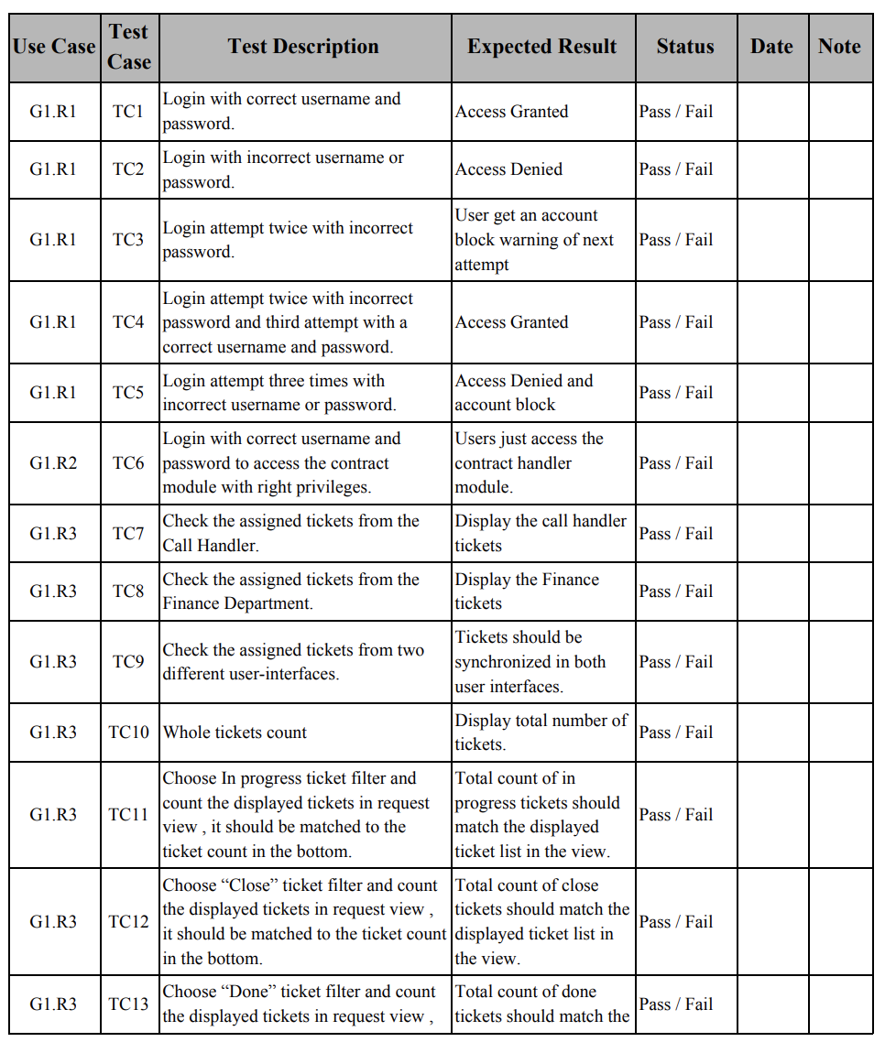
Requirement Test Matrix
(RTM)

Slide 5
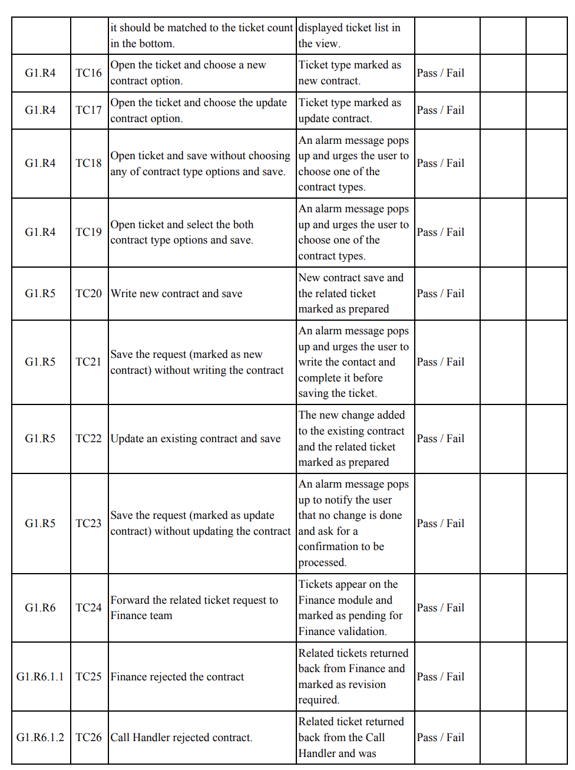
Requirement Test Matrix
(RTM)

Slide 6
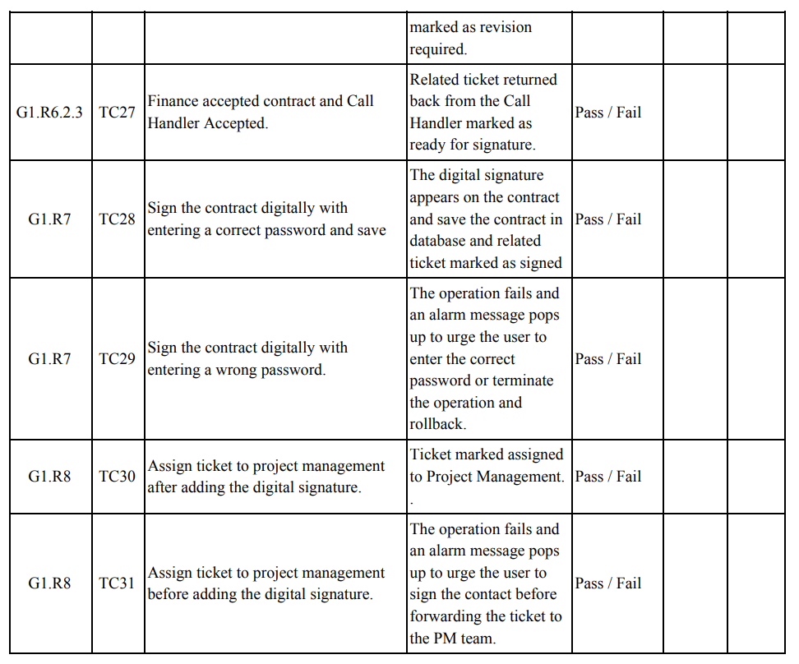
Requirement Test Matrix
(RTM)

Slide 7
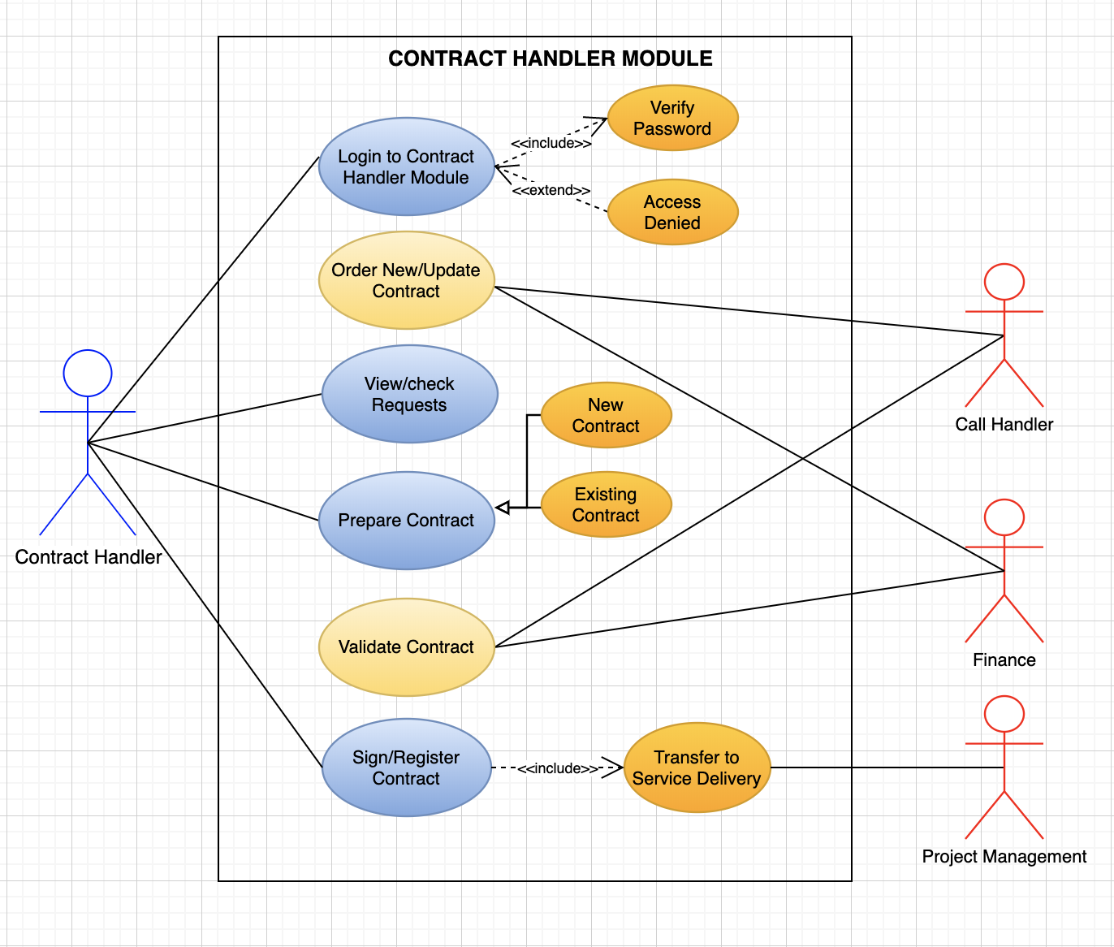
UML Use Case Diagram

Slide 8
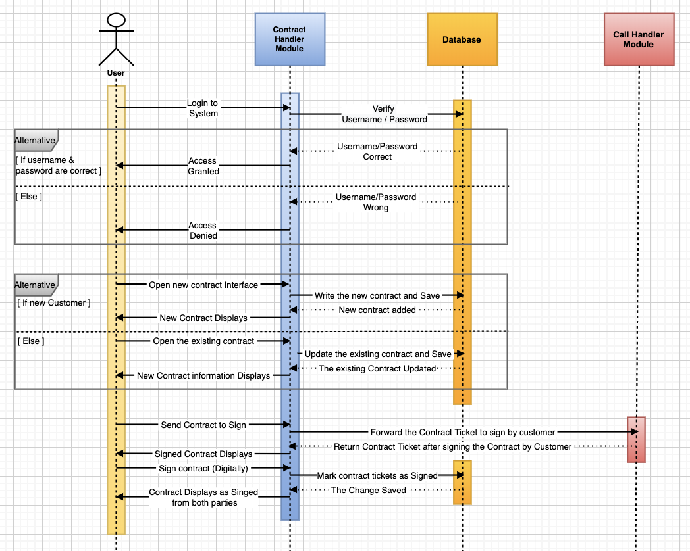
UML Sequence Diagram

Slide 9
Thank You!

